Slide 1
ALGO
TECTURE
ALGO
TECTURE
Notes:
Logo

Slide 2
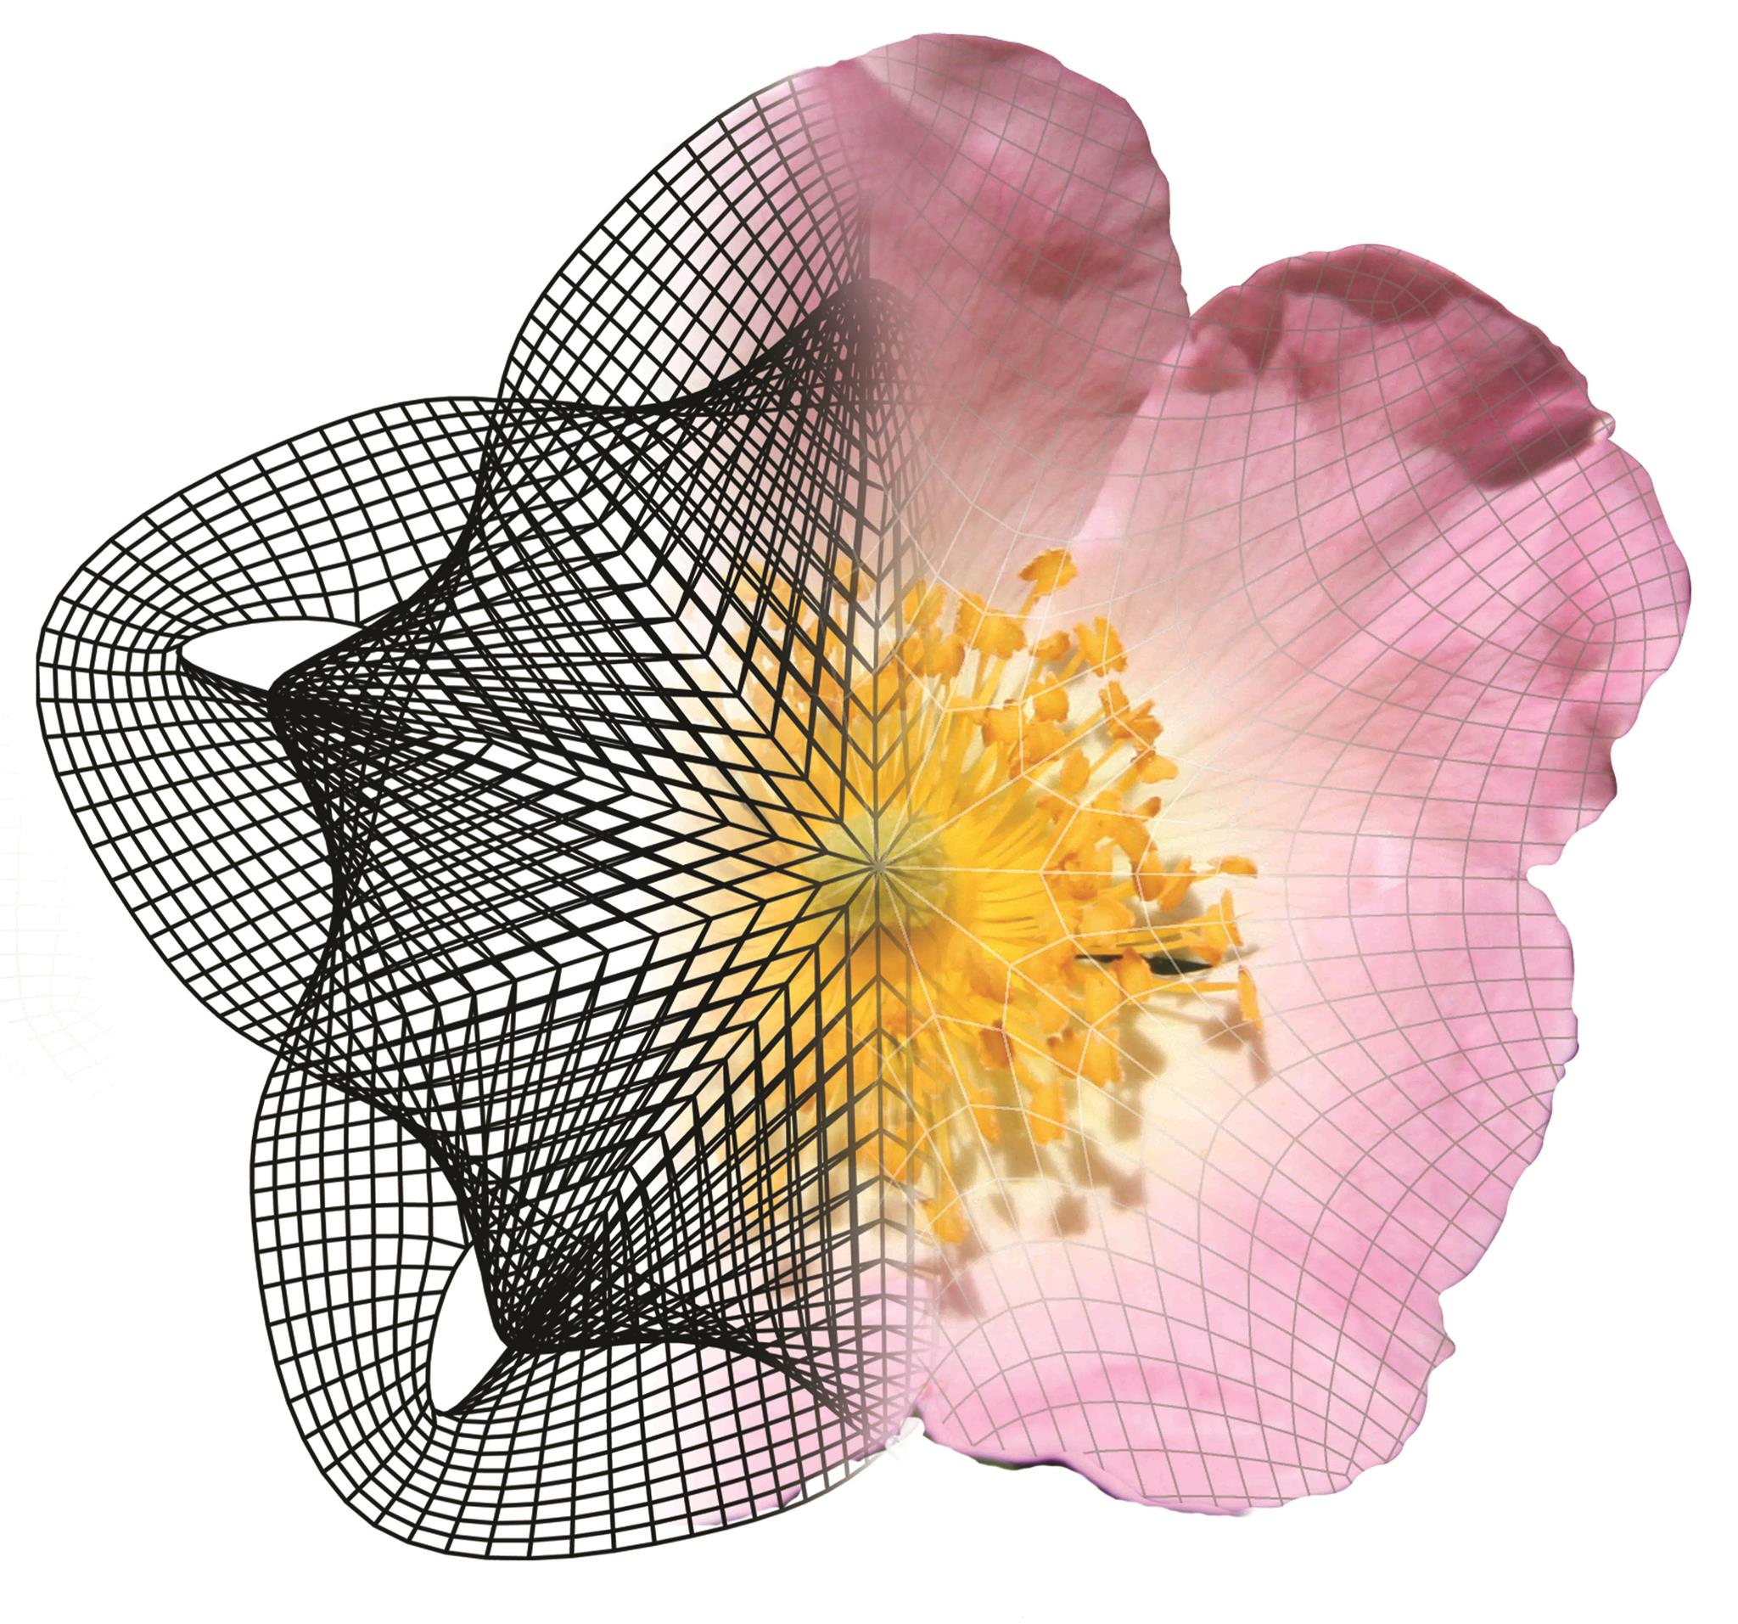
Introducing Buildings Digital Twin is not easy since a concept that the building and its digital representation are not literary "twins". That requires a little explanation or some thought or getting used to. you say "manages" you mean that it maintains a connection, manages information flow, assures accuracy, helps one do something better? Likewise, I'm not even sure what you mean by 'footprint' here, and I am somewhat familiar with the project. And you imply that a lifetime, life cycle is about planning, construction, launch, operations / maintenance?
THE DESIGN FRAMEWORK
algotecture manages digital twins of building and their footprints during the entire lifecycle by the blockchain-based technology
eocengineers
We have a shared vision of a pioneering structural design practice that truly integrates architecture and engineering. We enjoy working with a range of materials, forms and building types across diverse sectors and project scales to deliver extraordinary results.
video appearance like by airshaper or revolut with this popup
Notes:
getbootstrap/carousel, herokuapp - как сделана регистрация. Collaborative design process. Docker.com, snapcraft.io, track.siftery,
Taking some examples from oceanprotocol.com, build.snapcraft.io, What product algotecture is look like — horvath-partners/digitalisierung-als-zukunftschance-fuer-baukonzerne/
internetassociation.org, old version:algotecture manages digital twins of building and their footprints during the entire lifecycle. collaboration platforms as npmjs.com

Slide 3
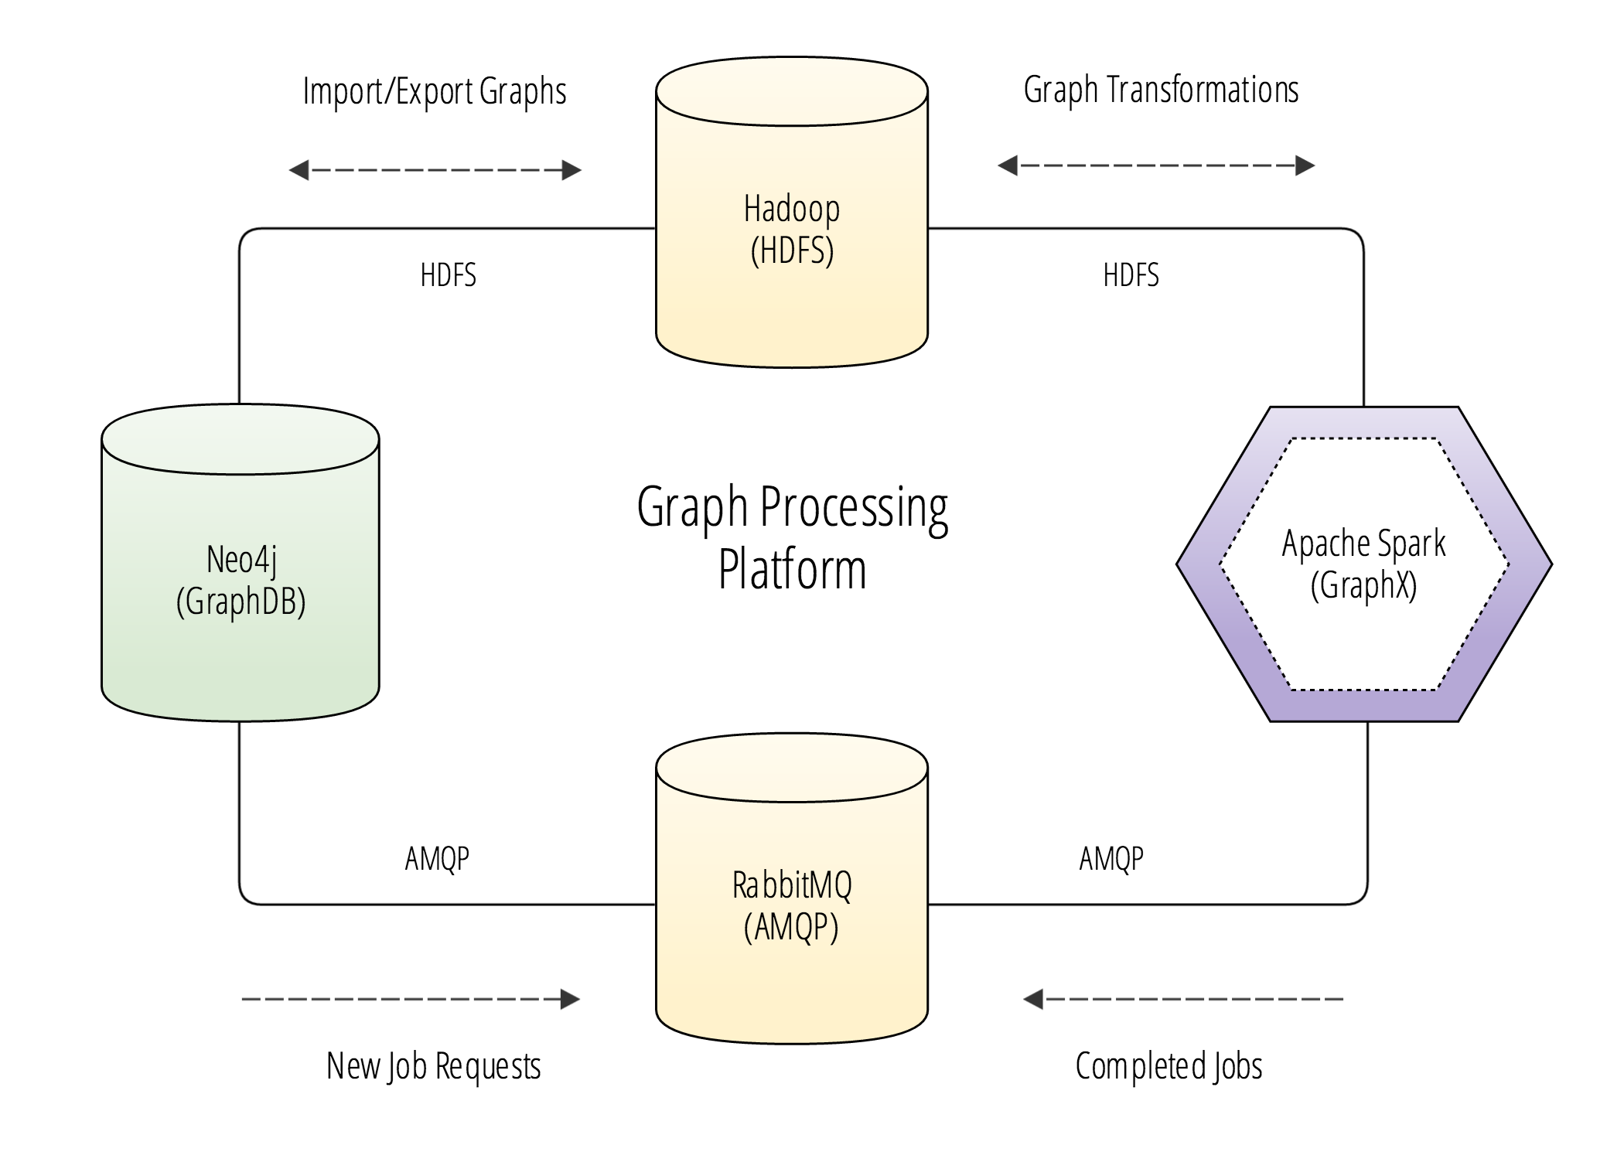
KW1: Start
KW10: Cover Page
developer.twitter
Chrome dev tools (see hyperledger/composer)
technology:
the computer vision library defines the human face landmarks, on the basis of which animation of digital avatars is generated directly in the web browser.
Notes:
Roadmap: for 2018, ems-group, itwo, rib/industries https://developer.twitter.com linkeddata.org SSI
Core technologies communication https://github.com/kbastani/spring-boot-graph-processing-example

Slide 4
https://streamlineicons.com/free/
https://shira-inbar.com/

Slide 5




algotecture
algotecture
Header stays during the scroll, is transparent and gray
first the header will be loaded and after the rest → wired
Links on different plattforms
Reference to the email at Marco and Walter. We should decide how the company will be finally named
Popup in the header with: facebook, linkedin, twitter, angel.co, crunchbase, reddit, instagram
angellist
Notes:
Header:

Slide 6
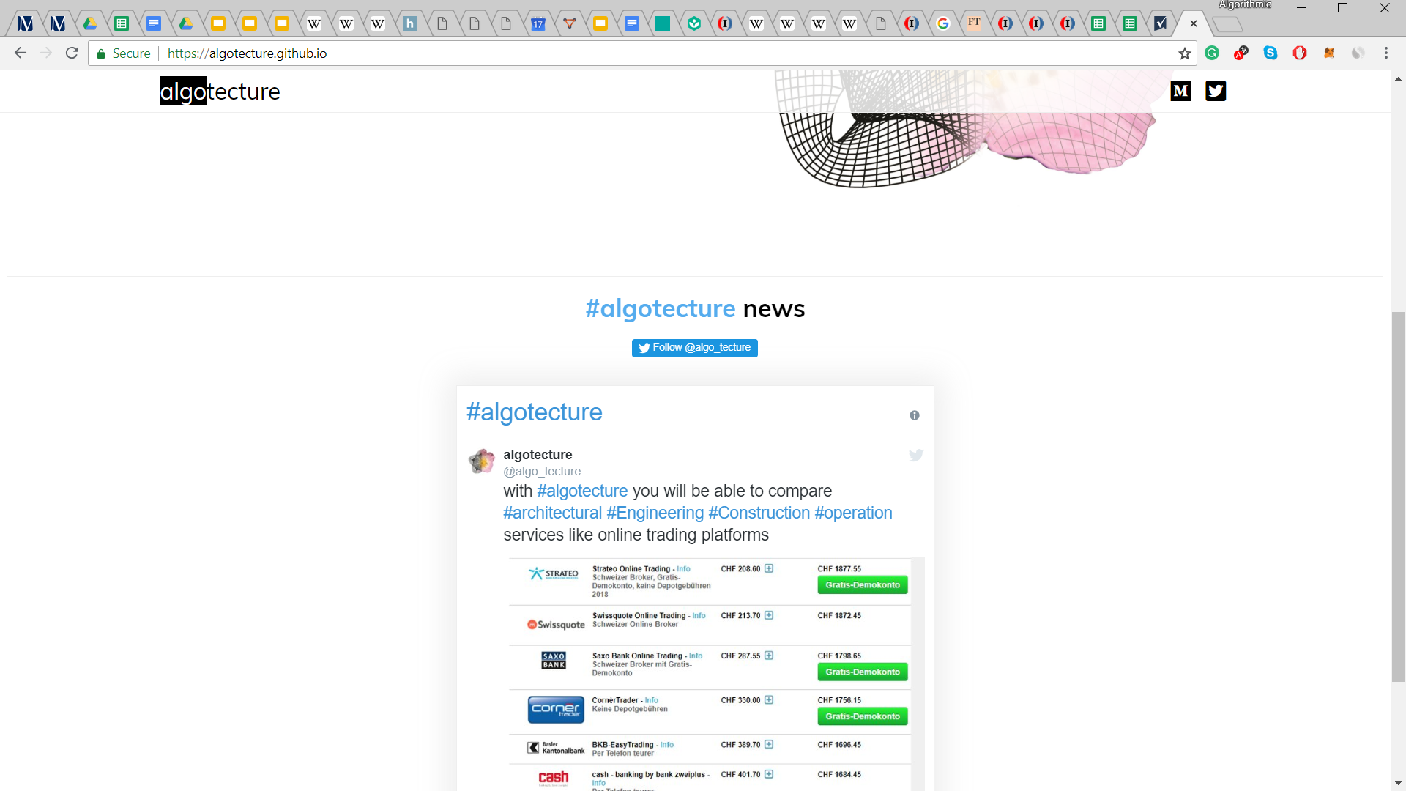
полоса
После полосы background gray
www.viant.io

Slide 7

нужен скрипт, который будет рендерить правильный год
algo tecture
THE DESIGN FRAMEWORK
© 2014-2018 algotecture. All Rights Reserved. info@algotecture.net
Moving bar → bloomberg, fuw
Parsing different databases, mining data from them and bringing that data outlined. Specific – twitter news with hashtag #BIM #algotecture #architecture #AEC #construction #digitalization
similarweb → information retrieval and visualization on the front page. Information retrivial from databases: http://www.faz.net/aktuell/finanzen/boersen-maerkte
Sign-up and get first news on content
JOIN
Your Email
Copyright © 2014-present, algotecture. All Rights Reserved. algorithmic.architecture@gmail.com
algotecture
DESIGN WORKS
algotecture
Notes:
Footer: fuw.ch, Algotecture News

Slide 8
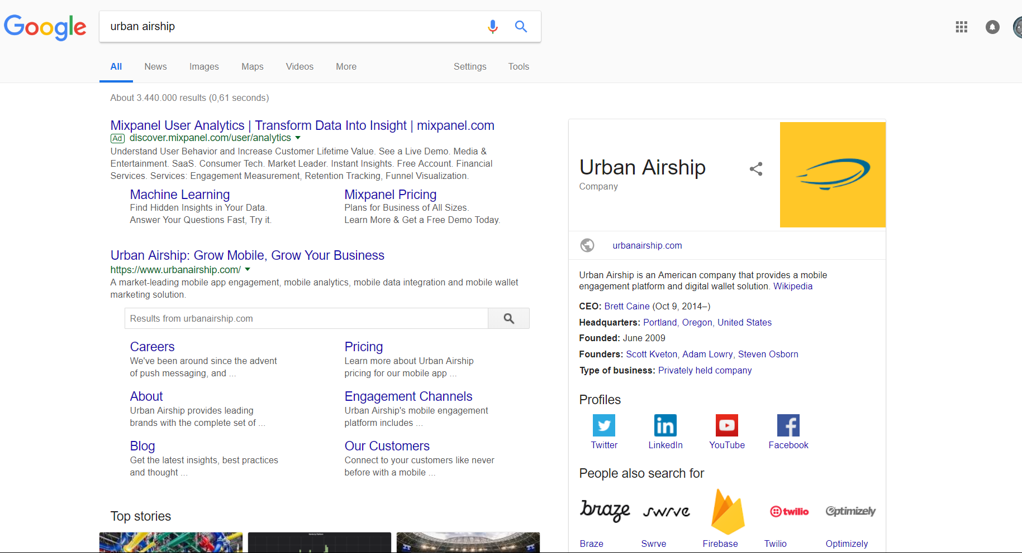
The main principle/idea is that the provided value of algotecture should be presented in a very attractive manere (HMI: iki/Human-computer_interaction)
Similarweb & npmjs.com → сделано каскадно и смотрится на всех платформах просто отлично!
revolut → после просмотра страницы приложение хочется скачать
Нужно чтобы когда люди гуглили появлялось вот что-то такое
Notes:
DESIGN & UX VALUES: metamask.io 3d on the front

Slide 9
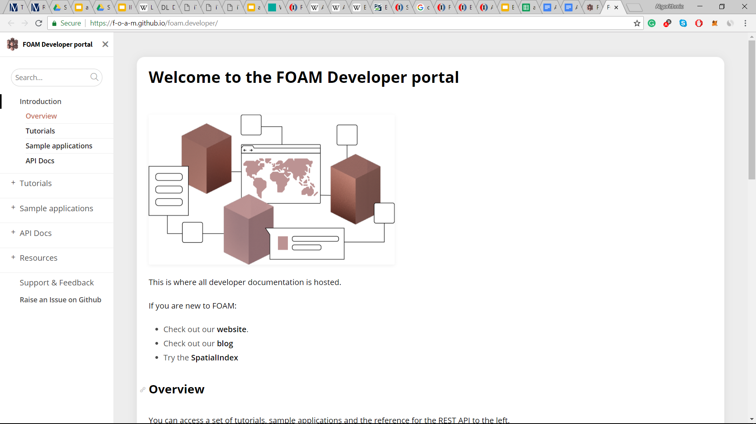
https://f-o-a-m.github.io/foam.developer/
Notes:
DEV: github.com/f-o-a-m/public-research

Slide 10
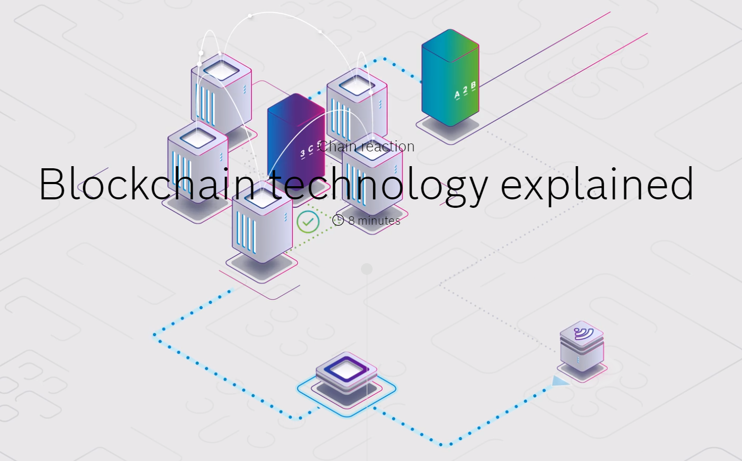
Notes:
Front site animation: https://www.bosch.com/stories/blockchain-technology-explained/ https://youtu.be/NKAanYdic9Q

Slide 11
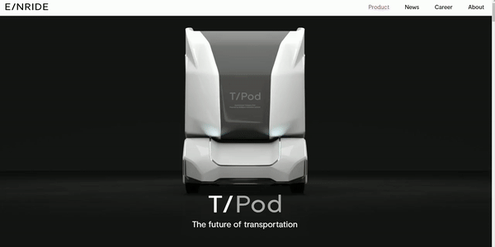
Product presentation
Notes:
PRODUCT: einride.tech/product

Slide 12
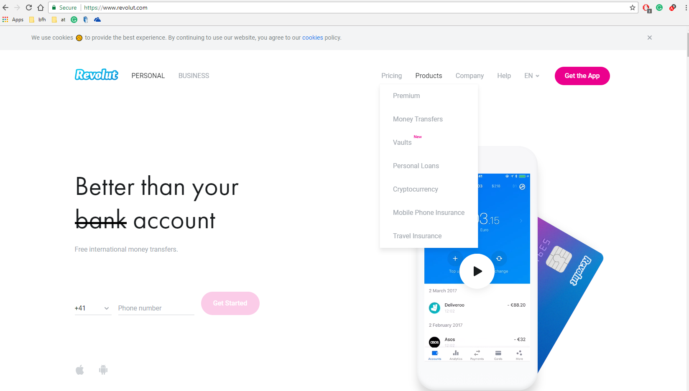
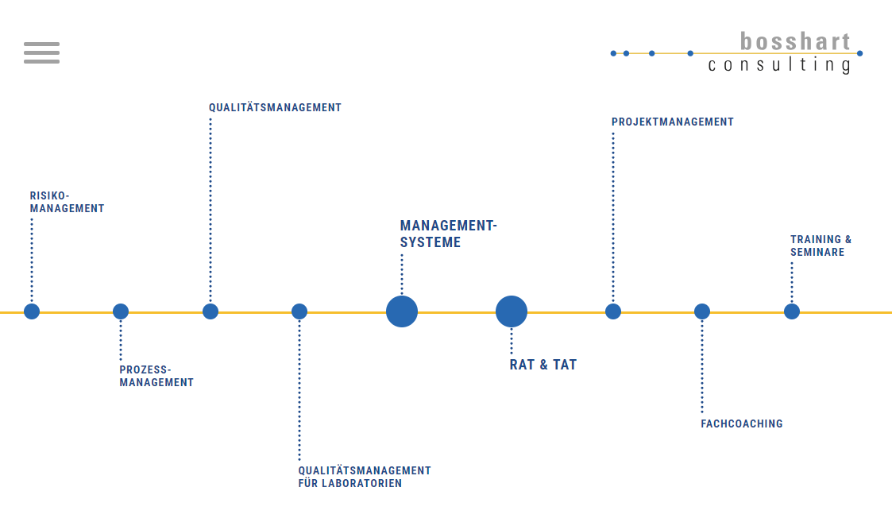
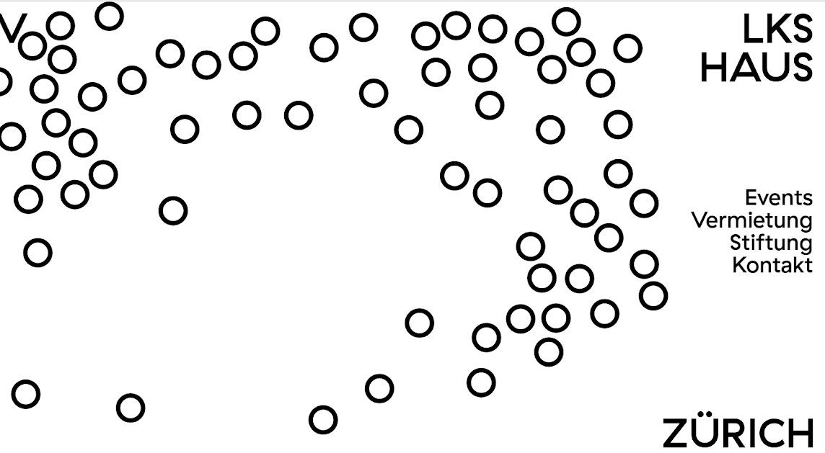
Value: wuestpartner, datahouse, irisvr.com
SECURITY: icebrg.io
Business Intelligence BI: sap/analytics/business-intelligence-bi, ibm/business-intelligence, oracle/business-analytics,
Notes:
UX:
@mbostock/metaballs, buildup.ch, stackoverflow/tags/d3.js, https://www.crypto-finance-conference.com/en/ revolut.com bosshart-consulting volkshaus.ch

Slide 13
timeline We radically simplify collaborative design, construction and operation processes by providing an intelligent framework.
DESIGN
CONSTRUCTION
OPERATION
Notes:
features: deeplearning.net с точки зрения маркетинга когда чел жмет на кнопки медиума или твитера, было бы очень круто если бы там была припаяна функция, которая позволяла предлагать following. сначала нужно задать вопрос а вы хотите зафоловать визионера димана (на самом деле algotecture - только сделал акаунт на медиуме)? они да или перейти на твитер/медиум димана.

Slide 14
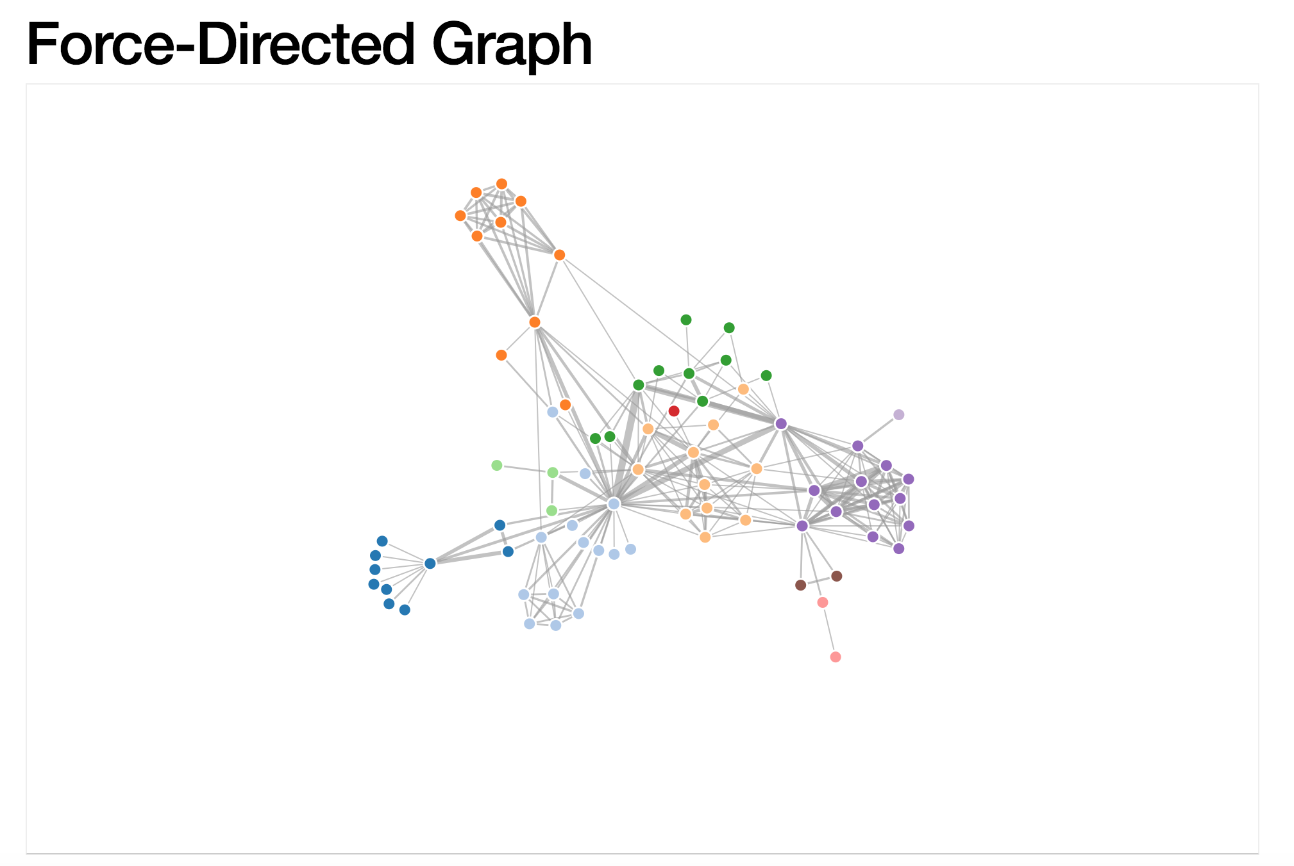
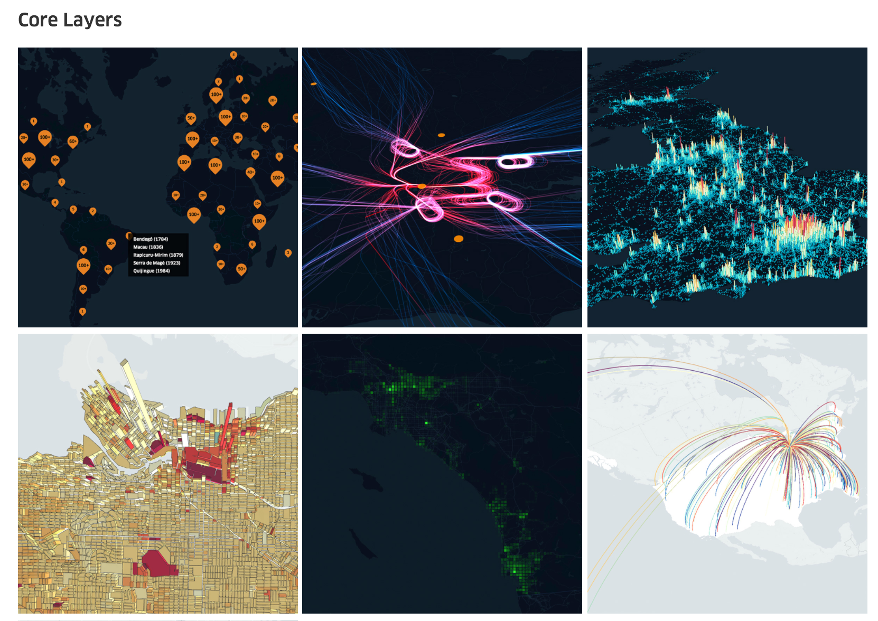
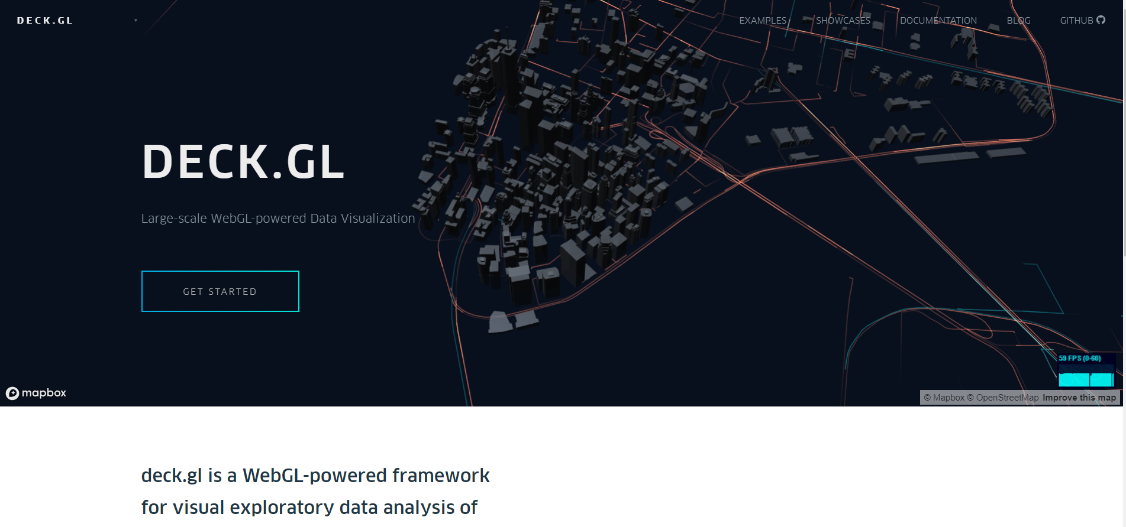
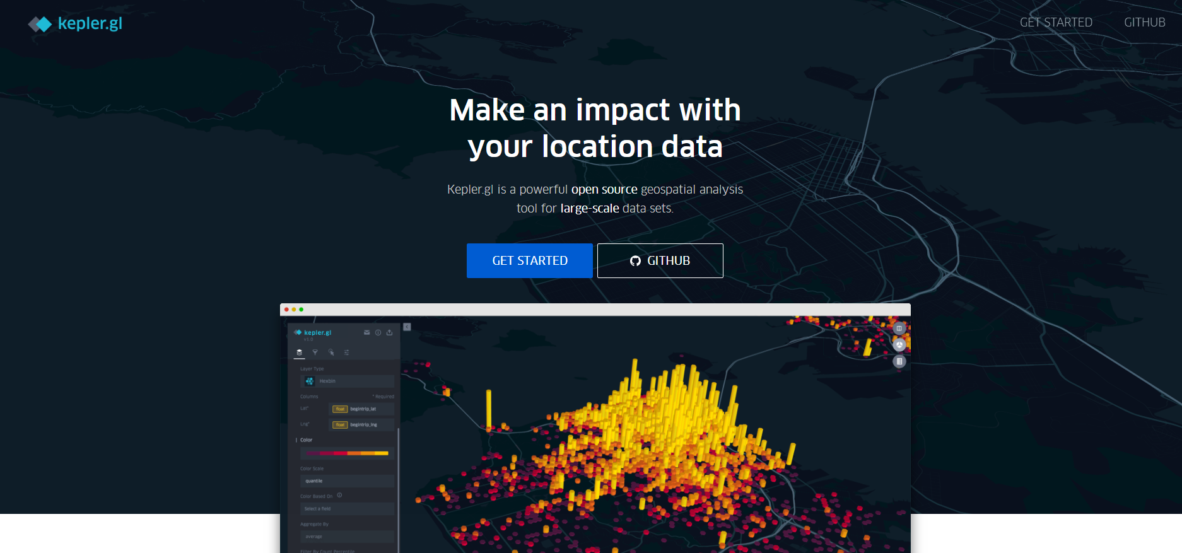
Notes:
dynamic interface: Force-Directed Graph, github/d3-request, github/d3-delaunay, github/mapbox/delaunator, github/d3/wiki, bl.ocks.org, devdocs.io/d3~3/chord-layout, d3/wiki/Gallery, mbtaviz.github.io
uber.github.io/deck.gl, uber.github.io/kepler.gl

Slide 15
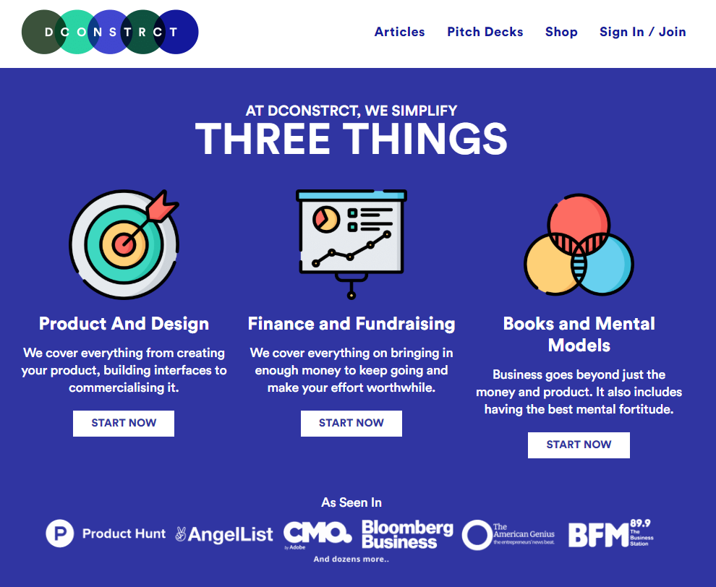
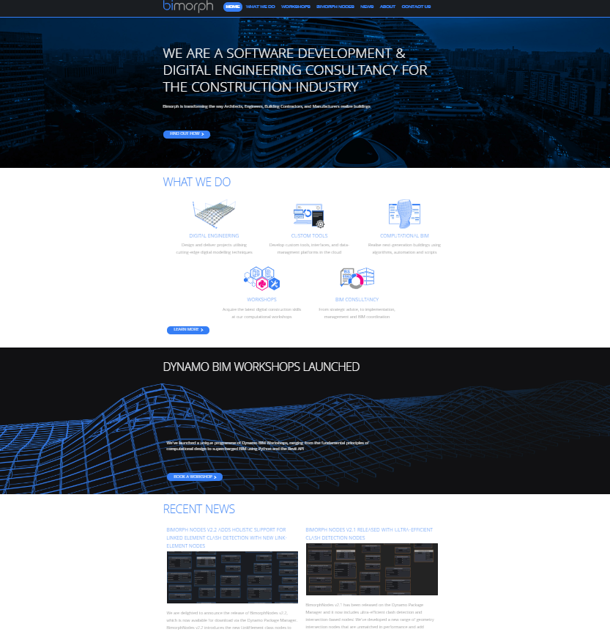
Notes:
Content:
masdfab.com, gym.openai.com, bimorph, dconstrct,

Slide 16
Trellis Linked Data Server → we provide a linked build asset data
Notes:
Use Cases:

Slide 17
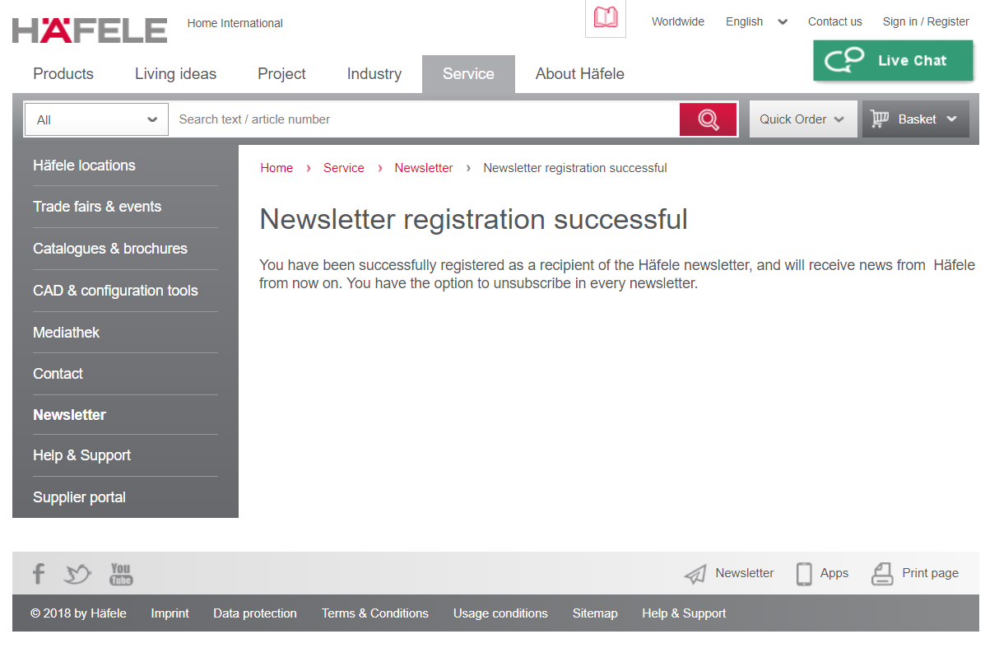

Slide 18
Name | Disrupt | Implement
ey.com |  | industries
topcoder.com | Crowdsourcing Platform | Easy/Clear Frontend
kickstarter.com | Investor Platform | Hosting Projects
kpcb.com | Reports Platform
jetbrains.com | Software Vendor for Developers | Userfriedly alternative for .NET solutions
pryv.com |  | Security first
arago.co | ai | ai
ipn.ch
symphony.com | Solution Platform
USP Examples

Slide 19
rest
IFC webserver (IFC-engine) Business Logic (API)
BC
Data control
BC
Digital Signature
Db - распределенная
Client interface
BC
Consensus Algorithm

Slide 20
REST
WP1 BIM Oriented Databank
WP2 BIM Interoperability
WP3 BIM Data Signature
WP4 Agreement Consensus
WP5 Collaboration Framework
BC
Data control
BC
Digital Signature
IFCwebserver.org Business Logic (API)
db
BC
Consensus Algorithm
Client interface
Notes:
search-NuDB,

Slide 21

REST
Client
Server
Entity Class
Entity Model
WebAPI Controller (Ctl)
BLogic
DBContext
Use Case: Create Model File
Model Project Model CPI
Mdl Logic.
new Job “Import”
File Archive
CPI, IFC
json
Server
CPI
IFC
Scheduler
FRM_JOB
viewer
Scheduler
MDL_OBJECT
Hoops Server
Renderserver
Model-part
Converter.exe
IFC Parser
Hoops API
Stream Cache

Slide 22
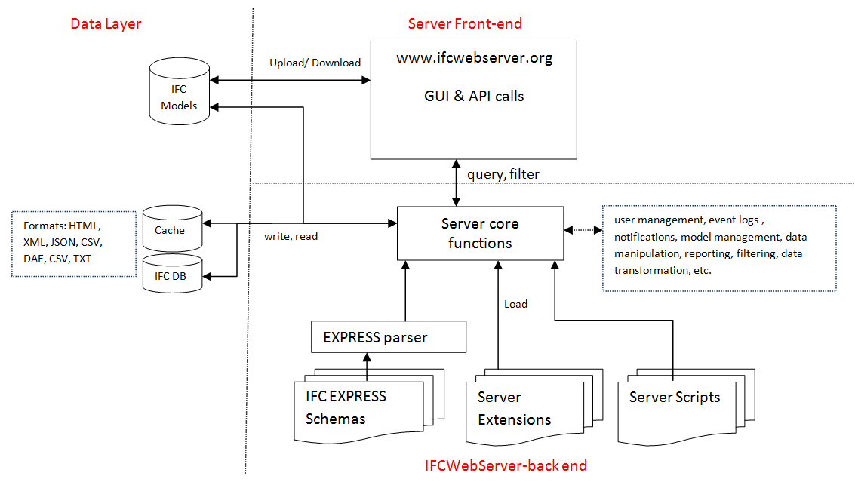
ifcwebserver system-architecture
Notes:
https://ifcwebserver.wordpress.com/system-architecture/

Slide 23
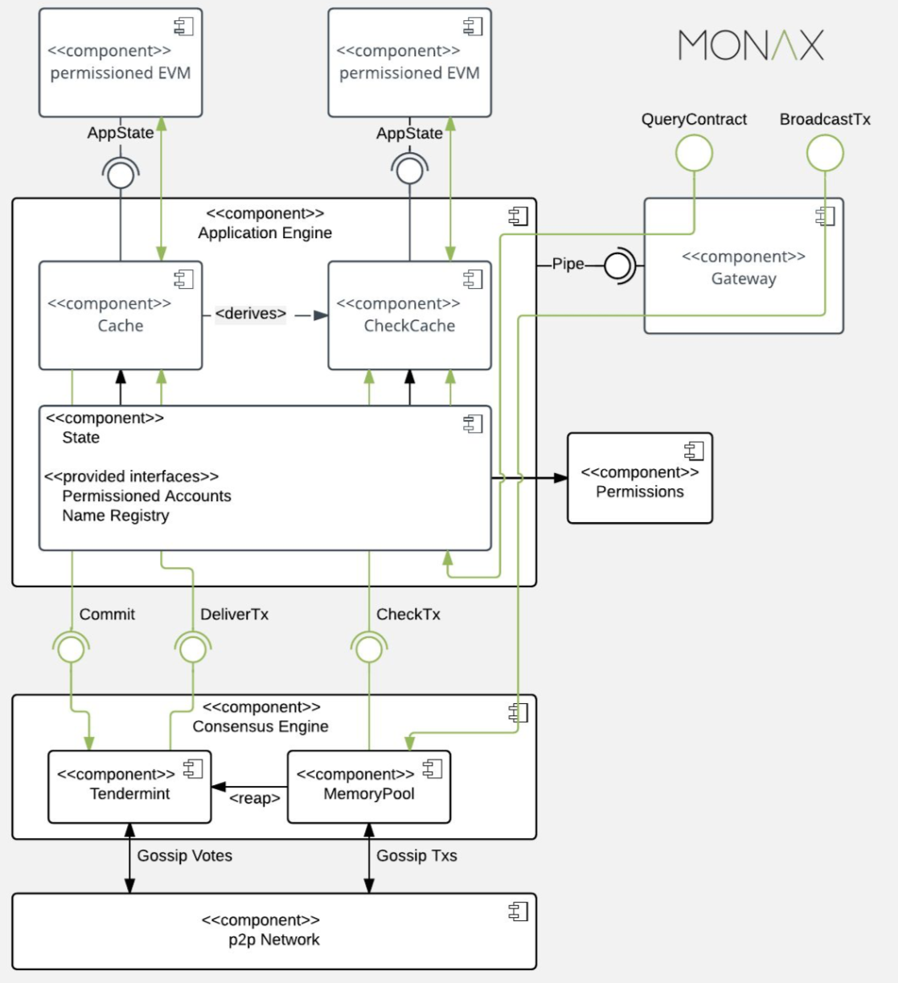
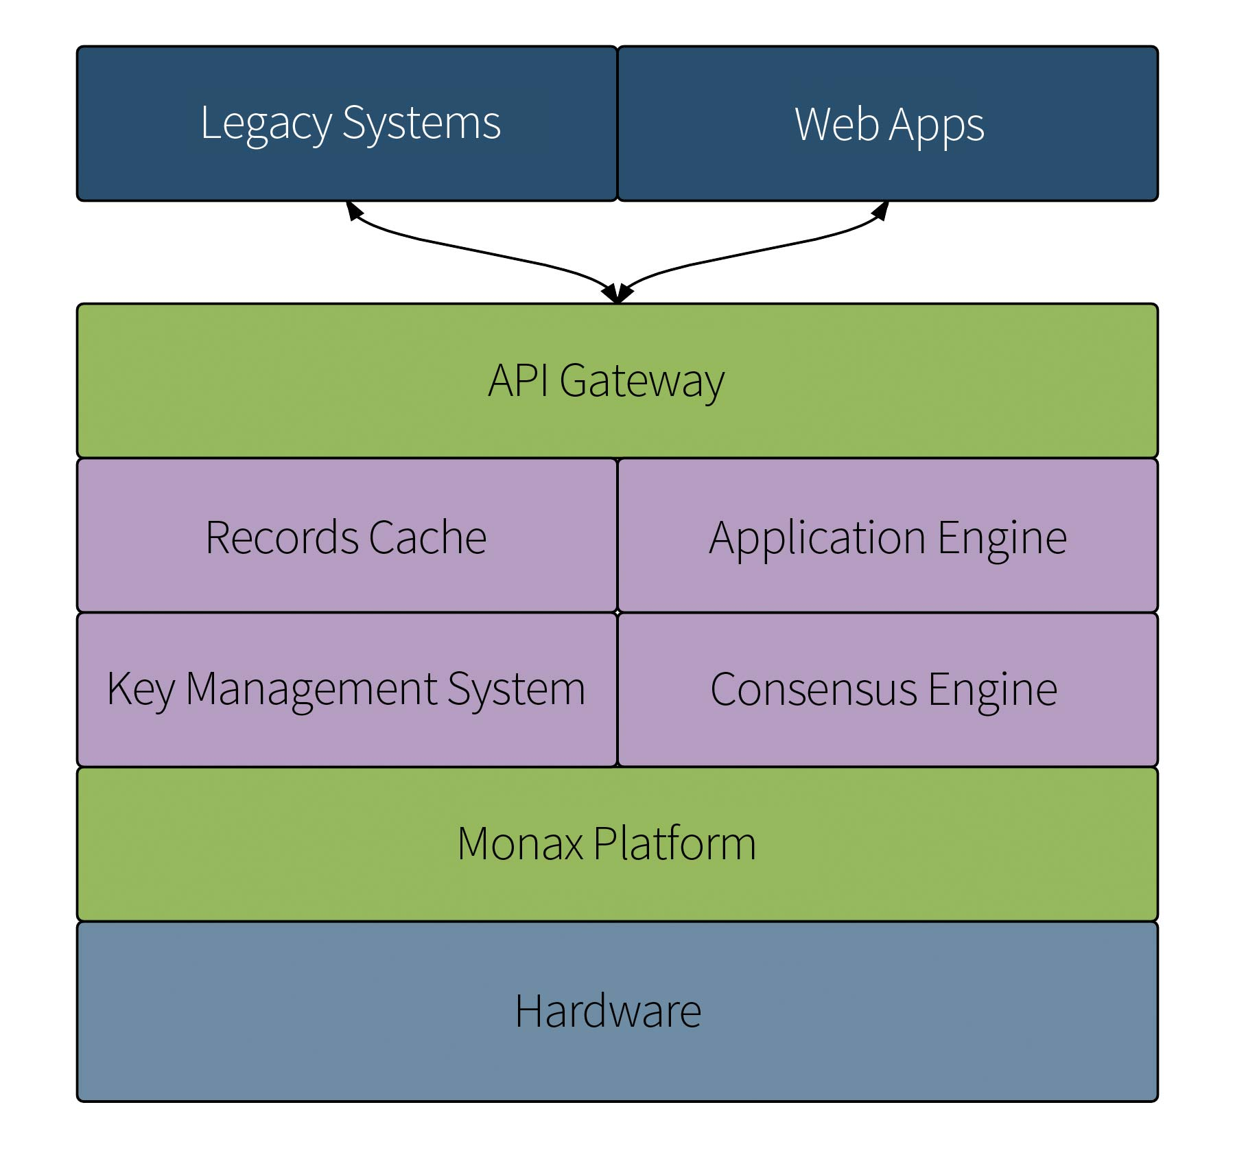
Hyperledger Burrow (formerly eris-db)
Notes:
monax.io, monax.io/platform,

Slide 24
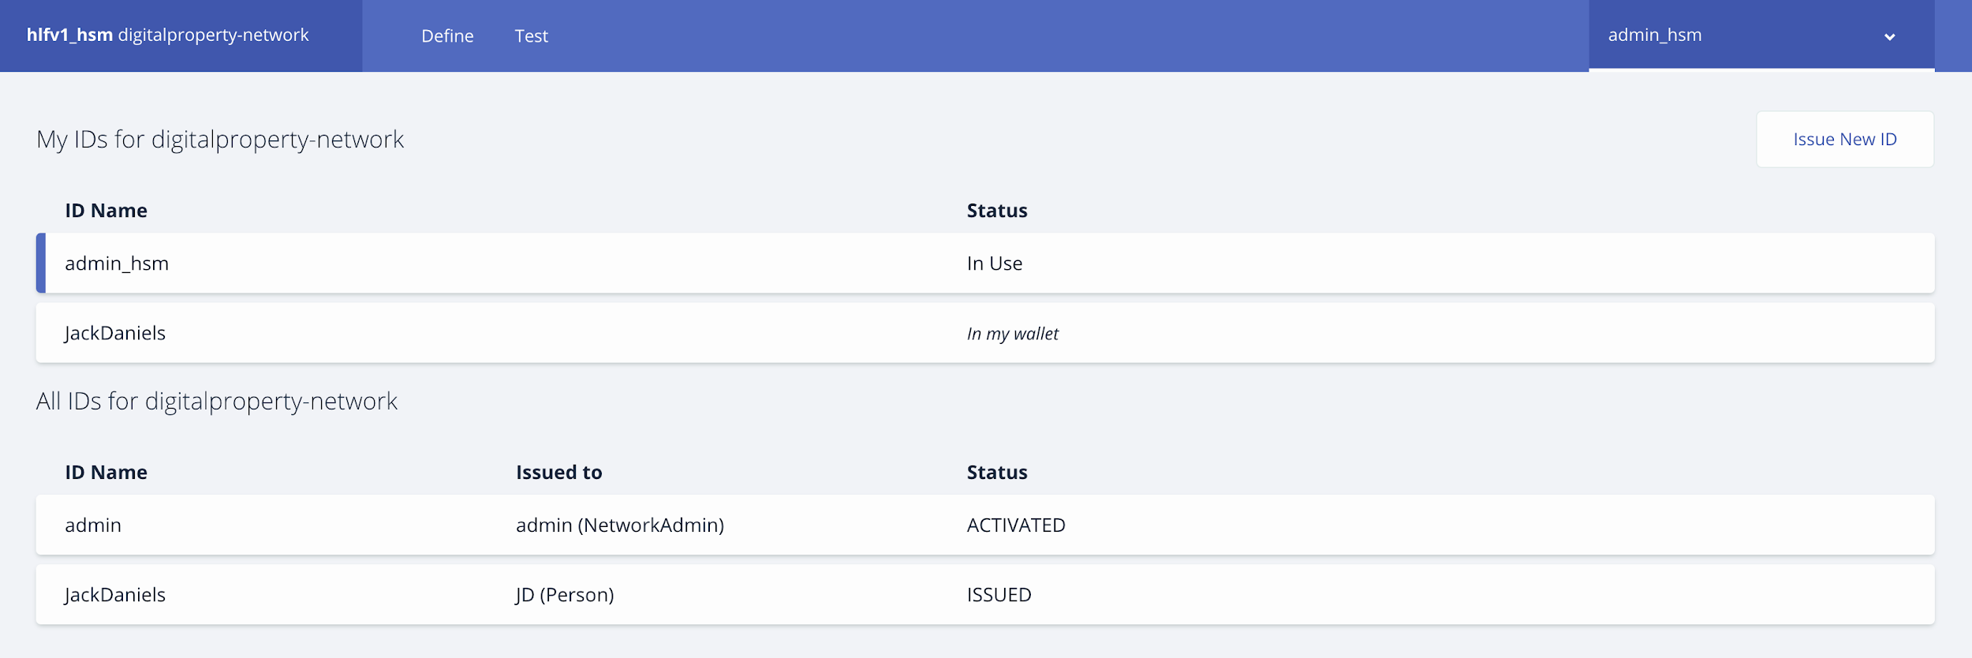
My talk as a Founder & CEO at algotecture, visiting the ETH in Zurich, not only some clear descriptions of how AI, Blockchain and Geometry work, but also some great discussion on how this affects the future of architecture.
“
Description: Will describe how complex systems relate to tokenized ecosystems, aka blockchains. I will describe AI DAOs (decentralized autonomous organizations) and how blockchains can be viewed as life forms. I will describe how blockchains help democratize access to AI data and algorithms. I will describe how best practices from evolutionary algorithms help in token design. I will describe how agent-based systems might be repurposed for simulation in a token design loop. In sum, the complex systems world has useful theory and tools for the blockchain world, and the blockchain world has highly relevant applied problems.
“

Slide 25
features
DEVELOPE
IMPLEMENT
DEPLOY
MAINTAIN
Notes:
Еще нужно что-то крутое чтобы люди ходили на страницу и говорили как круто, нужны партнеры – http://bcw.bosch-si.com/berlin/supply-chain-logistics/

Slide 26
fields
ARCHITECTURE
ENGINEERING
PRODUCT DESIGN
Notes:
planningandbuildingcontroltoday

Slide 27
fields
ARCHITECTURAL DESIGN
STRUCTURAL DESIGN
FAÇADE DESIGN
Notes:
planningandbuildingcontroltoday

Slide 28
FEATURES
ENVIRONMENTAL
SAFETY
SAFETY
Notes:
archilogic/features, gitlab/features, spring/projects,
qualifiziertes Raumprogramm

Slide 29
Notes:
https://uber.github.io/kepler.gl/#/demo/nyctrips

Slide 30
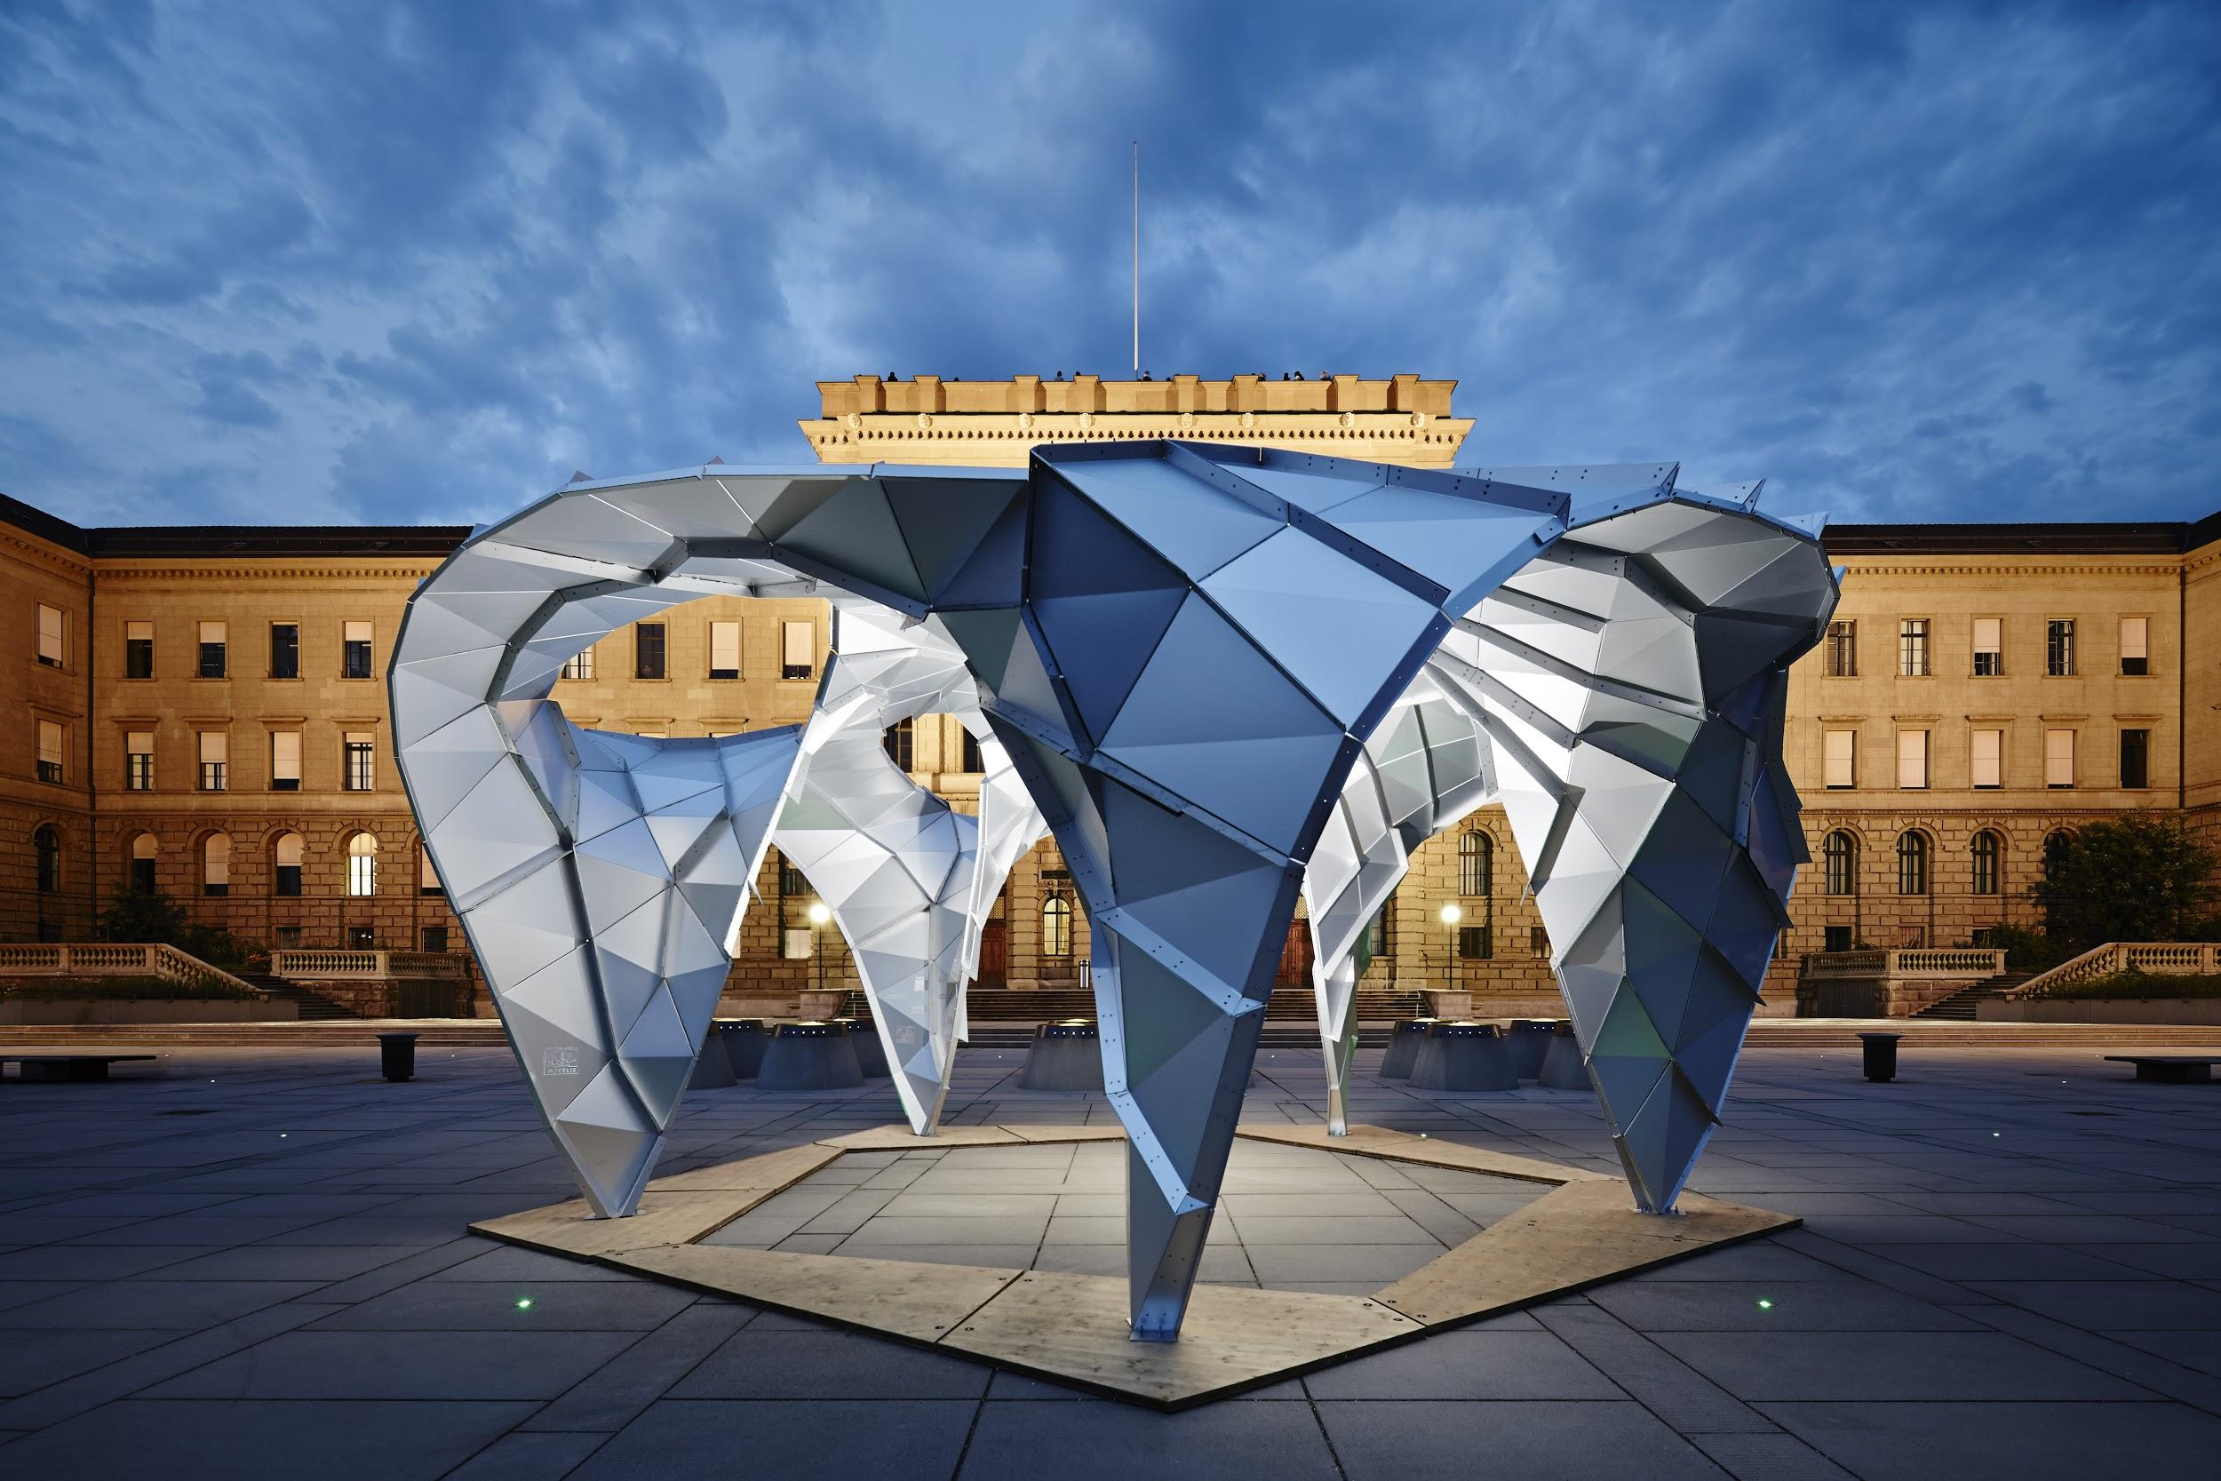
algo tecture
THE DESIGN FRAMEWORK
we radically simplify collaborative design, construction and operation processes by providing an intelligent framework
Sign-up and get first news on content
JOIN
Your Email
Notes:
getbootstrap/carousel, herokuapp - как сделана регистрация. Collaborative design process. Docker.com, snapcraft.io, track.siftery,
Taking some examples from oceanprotocol.com, build.snapcraft.io, What product algotecture is look like — horvath-partners/digitalisierung-als-zukunftschance-fuer-baukonzerne/
internetassociation.org,

